Slide 1
CIT2C23
Agile Methodology & Design Thinking
Case Study: Define (20%)
Student Name (Admin No.):
Tutorial Group:
Tutor:
Submission Date:

Slide 2
Declaration of Originality
I am the originator of this work and I have appropriately acknowledged all other original sources used as my references for this work.
I understand that Plagiarism is the act of taking and using the whole or any part of another person’s work, including work generated by AI, and presenting it as my own.
I understand that Plagiarism is an academic offence
and if I am found to have committed or abetted the offence of plagiarism in relation to this submitted work, disciplinary action will be enforced.
Name and Signature of Student:
<<Replace this with Name and Signature of student>>

Slide 3
Declaration on the use of Generative AI tools for assignments
Describe how you have used Generative AI tools such as ChatGPT or Dall.E-2 in your assignment.
Show snapshots of the conversations with the AI tool (i.e., the prompts you used and the response you get from the AI tool).

Slide 4
How do you indicate the reference?
The content generated by AI tools are not retrievable except by the user who generated them, so they are considered non-recoverable sources. Although non-recoverable data or quotations in APA Style papers are usually cited as personal communications, with ChatGPT-generated text there is no person communicating. Quoting text from ChatGPT chat is therefore more like sharing the output of an algorithm, with a reference list entry and the corresponding in-text citation.
According to the official APA Style site, ChatGPT references should be cited as:
E.g. OpenAI. (2023). ChatGPT (Sep 25 version) [Large language model].
https://chat.openai.com/chat
Important Note:
Do not copy answers produced by the AI tool in totality as it is considered as plagiarism.
Do not rely on any information produced by the AI tool blindly. You should always verify the answer with other sources. Do not assume that these answers provided by the AI tool are correct.
To achieve quality outputs from the AI tool, you should provide good prompt that is clear and specific. Be precise and provide context. Avoid asking open-ended questions.

Slide 5
Introduction
This project aligns with the course objectives by giving students hands-on experience in applying Agile methodology and design thinking to a real-world problem. It will assess their practical knowledge and technical skills in design thinking, Agile processes, and project management. The assessment includes three milestones—Define, Ideate, and Prototype.
This is an individual project
You will be given various case studies and must select one that aligns with your experiences and interests. The chosen case study will be used throughout this assessment as you develop a solution to address it.

Slide 6
Assessment Components
Case Study (80%)
• Part 1: Define (20% | 100 marks): Present a case study report that will be evaluated based on the clarity of the customer needs analysis, the alignment of product specifications with these needs, and the application of design thinking techniques.
• Part 2: Ideate (30%)
• Part 3: Prototype (30%)

Slide 7
Your case study report must include the following:
1. Problem Identification (20 marks)
Identify and list all key problems from the given scenario.
Clearly define the stakeholder needs and challenges. (Secondary research)
2. Solution Proposal, Key Features & User Interaction (40 marks)
Outline the functional and non-functional requirements of your proposed solution.
Specify whether it is a Web App or a Mobile App.
Define key functionalities and how they address the identified problems.
Identify your target users and explain how they interact with the solution.
3. Design Thinking Application (40 marks)
Use design thinking techniques to deepen user understanding and validate the solution’s feasibility:
User Persona:
Develop a persona representing a key segment of your target audience.
Include motivations, frustrations, and goals. (Primary research, insights)
Context Map:
Analyze the broader environment affecting the user experience.
Identify external factors influencing user behavior and decision-making.
Empathy Map:
Capture user emotions, thoughts, and behaviors.
Use insights to refine the product benefits and specifications.

Slide 8
1. Problem Identification (20 marks)
*Feel free to duplicate this slide if necessary
List down all the key problems identified from the scenario.
Problem Identified
Problem 1: [Clearly describe the problem] | Details: [Provide context and evidence from the scenario] | Who: [Who are the Primary & Secondary Stakeholders? ]
Why: [Why does this problem exist?] | What: [What impact does this problem have on users and stakeholders?] | Data and Evidence: [What evidence and insights support your problem identification?]

Slide 9
2. Solution Proposal, Key Features & User Interaction (40 marks)
*Feel free to duplicate this slide if necessary
Identify your Proposed Solution and list down all the key features of the proposed solution.
Proposed Solution
Insert the proposed solution name and elaborate what it does
Features
List down all the key features of the proposed solution

Slide 10
2. Solution Proposal, Key Features & User Interaction (40 marks)
*Feel free to duplicate this slide if necessary
Outline the functional and non-functional requirements of your proposed solution.
Functional Requirements | Non-Functional Requirements

Slide 11
2. Solution Proposal, Key Features & User Interaction (40 marks)
*Feel free to duplicate this slide if necessary
Specify potential users of your solution and how they interact with the application.
Potential User 1: <Replace this with Persona Name>
Feature | User's interaction with proposed solution
Feature A | Elaborate on all possible user interaction
Feature B
Feature C
Feature D
Feature E
..

Slide 12
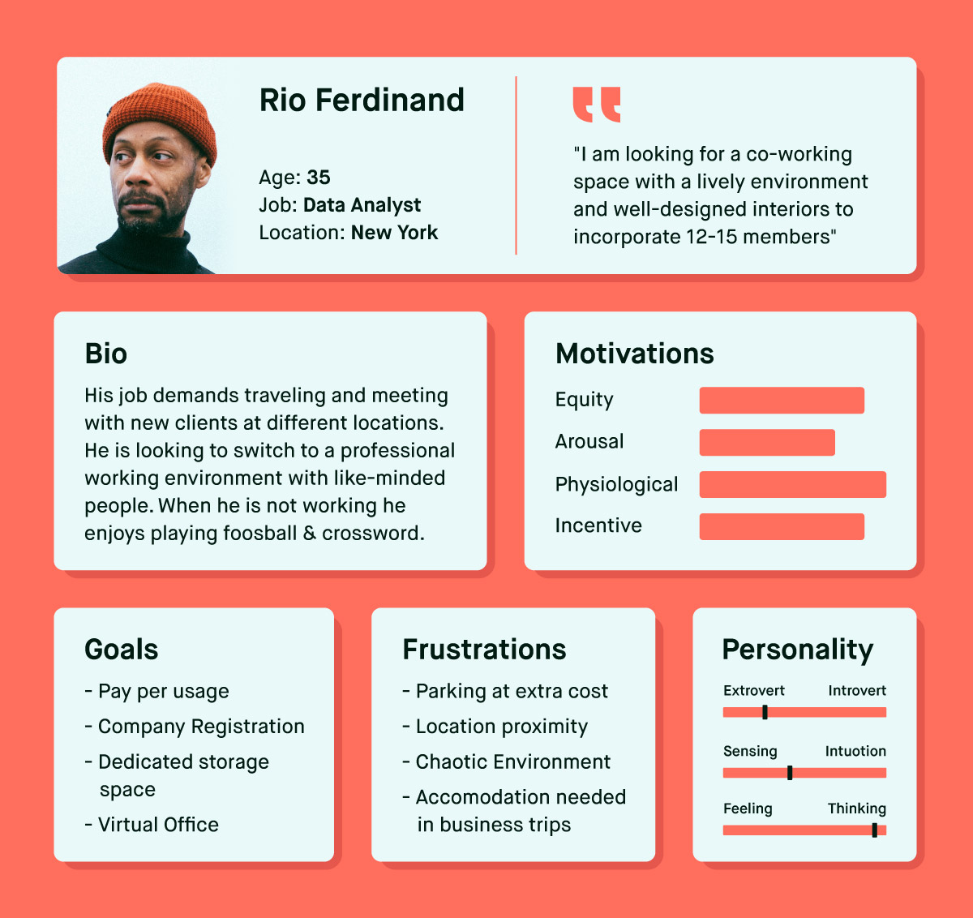
3. Design Thinking Application (40 marks)
*Feel free to duplicate this slide if necessary
Insert screenshots and description of persona design aids here.
Example:
Source: https://www.wowmakers.com/blog/user-persona/

Slide 13
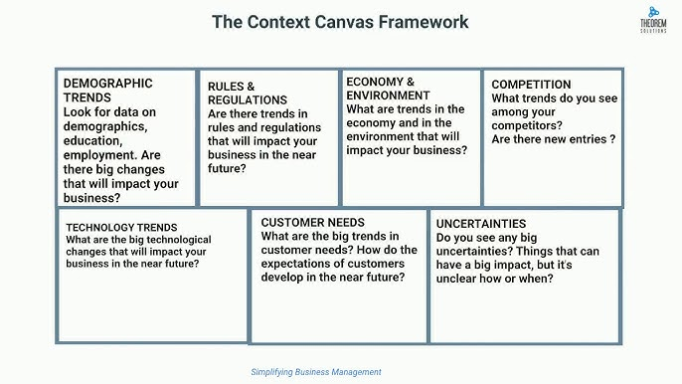
3. Design Thinking Application (40 marks)
*Feel free to duplicate this slide if necessary
Insert screenshots and description of context map design here.
Example:
Source: https://www.youtube.com/watch?v=DdMl-DHs05k

Slide 14
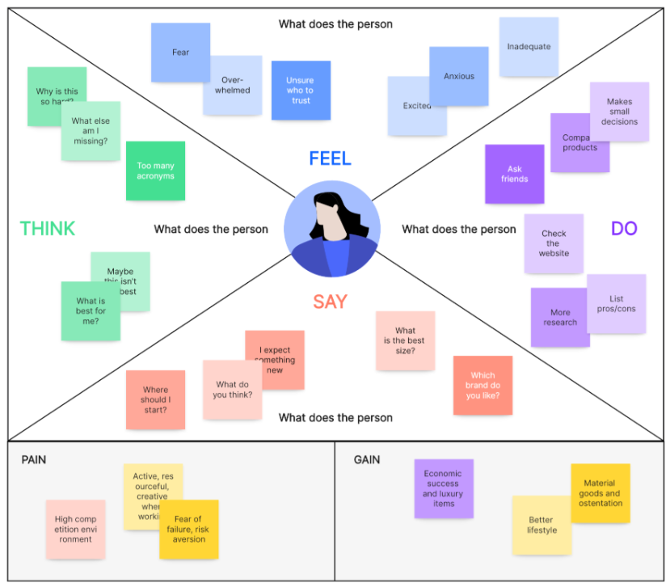
3. Design Thinking Application (40 marks)
*Feel free to duplicate this slide if necessary
Insert screenshots and description of the empathy map design here.
Example:
Source: https://boardmix.com/examples/empathy-map-example-for-students/

Slide 15
References

